Slide 1



Sustainable Supply chain Performance Dashboard in Power BI
Student Name: Katakam Anitha
Student ID : STU646caad9a69541684843225
College Name: Sri Venkateswara College of Engineering and Technology

Slide 2

Learning Objectives
The objective of this project is to develop an interactive Sustainable Supply Chain Performance Dashboard using Power BI to monitor, analyze, and optimize key supply chain metrics. This dashboard will provide real-time insights into critical areas such as supplier performance, inventory management, lead times, logistics costs, and environmental impact. By visualizing these metrics, businesses can make data-driven decisions to enhance efficiency, reduce costs, improve sustainability, and ensure a more resilient supply chain.
GOAL
Source :
www.freepik.com/

Slide 3
Data Collection & Storage:
Microsoft Excel / CSV Files – Storing and importing supply chain data
Data Processing & Transformation:
Power BI – Data cleaning, transformation, and ETL
DAX (Data Analysis Expressions) – Custom calculations and aggregations
Data Visualization & Reporting:
Power BI – Interactive dashboards and real-time analytics
Custom Power BI Visuals – Treemap, Funnel, slicer, area chart etc.,
Automation and Scheduled Refresh:
Schedule automatic data refreshes in Power BI Service to keep reports up to date.
Ensures that real-time supply chain insights are available for better decision-making.
Security:
Implement role-based access control (RBAC) to restrict access to sensitive supply chain data.
Ensure data encryption and compliance with industry security standards.
Tools and Technology used

Slide 4
Methodology
1. Data Collection & Integration
Extracted from Excel, SQL Databases, APIs, and real-time feeds.
Included supplier performance, inventory levels, lead times, and logistics costs.
2. Data Cleaning & Transformation
Used Power Query in Power BI for data preprocessing and transformation.
Removed duplicates, handled missing values, and standardized data formats.
3. Data Modeling & Calculations
Created relationships between datasets for better insights.
Used DAX formulas to compute key metrics like Cost per Order, Supplier Defect Rate, and On-Time Delivery Rate.

Slide 5
4. Data Visualization & Dashboard Design
Developed interactive dashboards with various Power BI visuals:
Slicer -product type, customer demographics
Clustered bar chat - sum of revenue generated by product type, sum of shipping costs and sum of shipping times by transportation modes
Pie chart - sum of quantities by customer demographics
Donut chat - sum of Number products sold by supplier name
Funnel - sum of Lead time by Routes
Stacked column chat - sum of number of products sold by Routes
Treemap - sum of order quantities by shipping carriers
Card - total number of products sold, total number of routes, total number of shipping carriers, total number of suppliers, total number of transportation modes, total number of locations
Area chat - sum of products volumes by lead time .

Slide 6
5. Automation & Scheduled Refresh
Power BI Service was used to schedule automatic data refreshes.
Implemented real-time alerts & notifications for critical supply chain performance.
6. Security & Access Control
Role-Based Access Control (RBAC) to restrict access to sensitive data.
Ensured data encryption & compliance with security standards.
A real-time, data-driven, interactive Power BI dashboard that helps optimize supply chain efficiency, reduce costs, and enhance sustainability.

Slide 7
Lack of Real-Time Insights
Difficulty in tracking supplier performance, logistics, and inventory levels effectively.
High Operational Costs
Inefficient supply chain processes lead to delayed deliveries and increased costs.
Limited Sustainability Tracking
No proper system to measure carbon footprint, energy usage, and eco-friendly practices.
Complex Data & Poor Decision-Making
Unstructured data and lack of visualization make analysis slow and ineffective.
Problem Statement:

Slide 8
Solution:
Power BI-based Sustainable Supply Chain Dashboard.
Real-time insights for better supply chain visibility.
Interactive visualizations to track costs, performance, and sustainability.
Automated data processing & alerts for proactive decision-making.
Result:
cost-effective, efficient, and sustainable supply chain

Slide 9
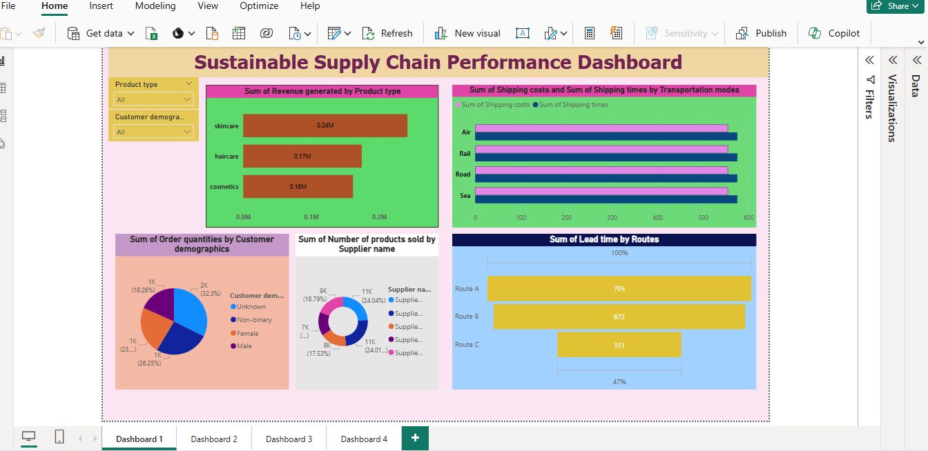
Screenshot of Output:

Slide 10
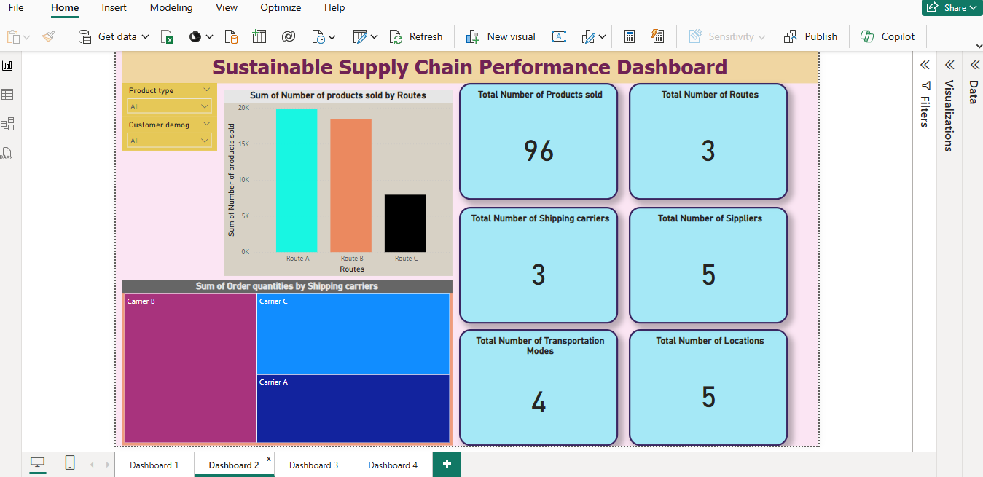

Slide 11
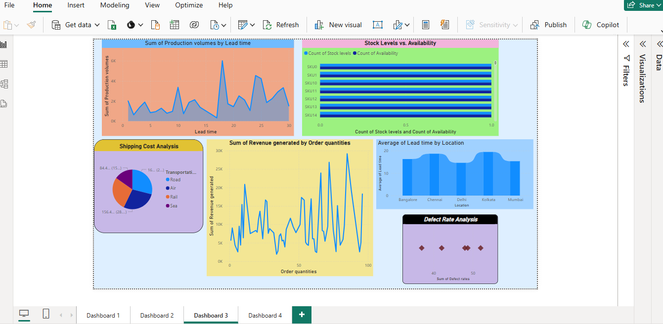

Slide 12
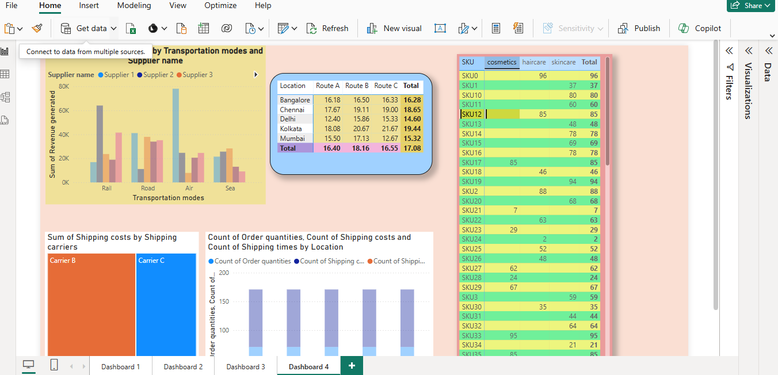

Slide 13
Conclusion:
The Sustainable Supply Chain Performance Dashboard, developed using Power BI, is a powerful tool that enables real-time monitoring, analysis, and optimization of various supply chain operations. By integrating interactive visualizations, automated data updates, and advanced analytics, the dashboard helps organizations enhance efficiency, cost-effectiveness, and sustainability.
Key Achievements
Cost Optimization & Financial Efficiency
Provides a clear breakdown of costs associated with procurement, transportation, warehousing, and returns.
Identifies areas where cost savings can be implemented through automation, supplier selection, and inventory control.
Uses Waterfall Charts to analyze cost fluctuations at different supply chain stages, highlighting critical expense areas.
Helps businesses make data-driven budgeting and forecasting decisions to improve profit margins.

Slide 14
Supplier Performance & Logistics Optimization
Tracks key supplier metrics, such as on-time delivery percentage, lead time, and defect rates.
Uses Key Influencer Analysis to identify factors that impact supplier reliability and logistics efficiency.
Helps companies choose the best suppliers based on performance trends, cost efficiency, and sustainability ratings.
Improves logistics by analyzing transportation delays and optimizing routes using map-based visualizations.
Sustainability Insights & Compliance Monitoring
Measures carbon footprint, energy consumption, and waste reduction initiatives.
Ensures compliance with corporate sustainability goals, industry standards, and government regulations.
Uses Heatmaps to analyze regional sustainability performance and highlight eco-friendly logistics hubs.
Helps organizations reduce their environmental impact while maintaining supply chain efficiency.

Slide 15
Real-Time Data Integration & Automation
Automatically updates data from multiple sources, reducing the need for manual entry.
Provides real-time alerts and notifications for supply chain disruptions or performance drops.
Uses AI-driven predictive analytics to forecast potential delays, cost overruns, and inventory shortages.
Improves decision-making with dynamic dashboards that adapt to changing business conditions.
Advanced Visualization & Data Analysis
Uses a combination of charts, graphs, and KPI indicators to provide a comprehensive supply chain overview.
Includes interactive dashboards for inventory tracking, supplier ranking, and performance comparisons.
Drill-down capabilities allow users to explore detailed insights on specific suppliers, regions, and logistics processes.
Helps leadership teams quickly identify problems and take corrective actions.

Slide 16
Final Impact & Business Benefits
With this Power BI-driven dashboard, businesses can achieve:
Increased efficiency in supply chain operations through data-backed decision-making.
Significant cost savings by identifying areas of waste and inefficiencies.
Enhanced supplier collaboration by improving visibility and performance tracking.
Better risk management through predictive analytics and real-time monitoring.
A more sustainable and responsible supply chain, aligning with global environmental goals.
Long-Term Value
“By integrating this dashboard into daily operations, companies can build a resilient, future-ready supply chain that supports both profitability and sustainability. The data-driven approach ensures better adaptability to market changes, improved operational efficiency, and a competitive edge in the industry.”

Slide 17
Thank you..!

